Slide 1

Real Time Object Detection
using TensorFlow
Team Members:
17BQ1A05M5
17BQ1A05I1
17BQ1A05J9
17FO1A05G1
Mentor:
Mr.Sk.Khaja Mohiddin

Slide 2
Abstract :
This project explains the concept of object detection through TensorFlow using the Object Detection API.
When an object is placed infront of webcam it detects the object and raises a popup describing the object.
This is helpful to people what the object is and can be used in various other projects inorder to recognize the objects.
This can also be helpful to the uneducated people to gain knowledge about several objects which are not known to them.
For example, if a person doesn’t know anything about playing cards he/she can identify what the card i,e: King,Queen,Jack etc.

Slide 3
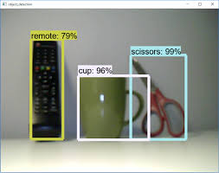
Object Detection
The process by which machine(computer) can identify what the object by using camera is called as Object detection.
Object Detection is done using Convolutional Neural Networks(CNN).
Applications:
Security
Surveillance
Automated vehicle systems

Slide 4
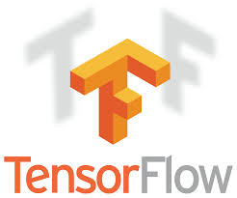
TensorFlow:
TensorFlow is an open source software library released in 2015 by Google to make it easier for developers to design,build and train deep learning models.

Slide 5

System Requirements:
Processor - I3 and above
RAM - 4gb and above
Web Camera
High Speed Internet

Slide 6
Software Requirements:
Python (3.4 and above)
Anaconda(latest version)
Tensorflow
Tensorboard
protobuf v3.4 or above
Other modules:
Cython
contextlib2
Pillow
lxml
Jupyter
matplotlib

Slide 7
Object Detection Workflow:
Every object algorithm may have a different way of working,but they all work on same principle. As follows
Training Data
Testing Data
Feature Extraction
Classification

Slide 8
Protobuf: Protocol Buffers (Protobuf) are Google’s language-neutral, platform-neutral, extensible mechanism for serializing structured data, – think of it like XML, but smaller, faster, and simpler.
COCO Dataset:
COCO : Common Objects in Context
COCO is a large-scale object detection, segmentation, and captioning dataset.
Homepage : http://cocodataset.org/#home

Slide 9
Description:
The project has been developed with help of python as it’s extremely diverse and has useful modules.
After installing all the required softwares (like python,anaconda,protobuf etc) from Tensorflow Github the models are downloaded.
This models contain the “TensorFlow Object Detection API” and related files.
Next, we need to go inside the Tensorflow folder and then inside research folder and run protobuf from there using this command:
"path_of_protobuf's bin"./bin/protoc object_detection/protos/
The file named project.py is executed to do the real time object detection.
All this process is done in Anaconda environment with high speed internet support.

